Slide 1
Running Start Help Session

Slide 2
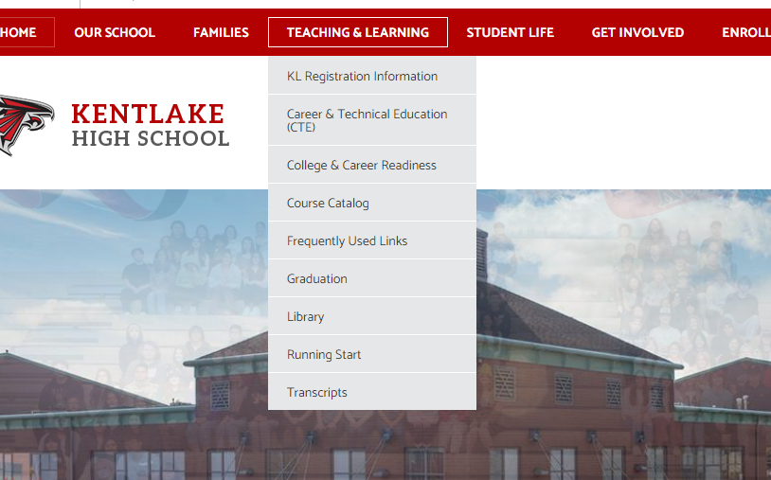
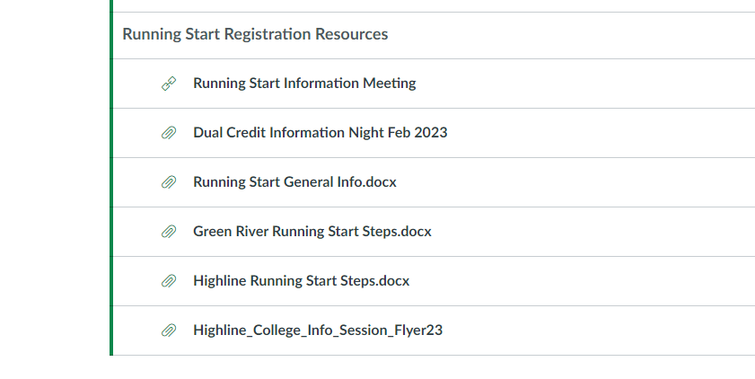

Slide 3
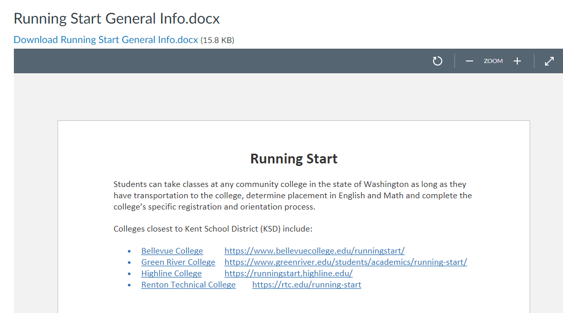

Slide 4
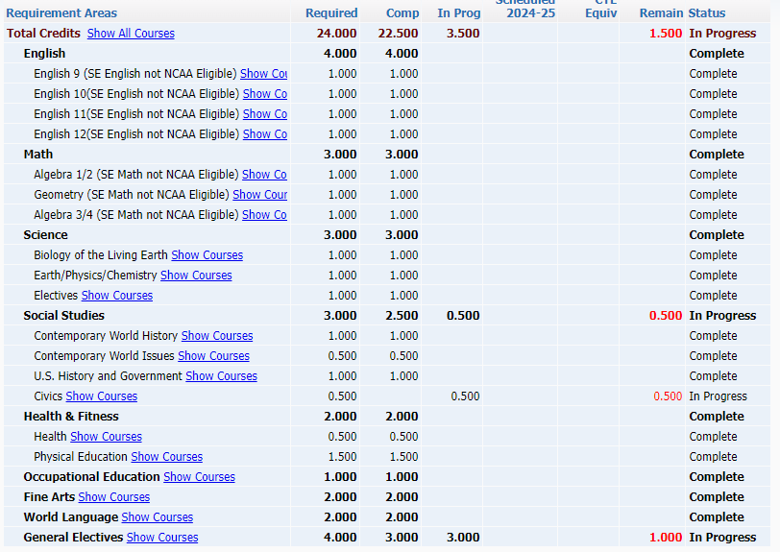
Getting Started with Running Start
After you complete:
Application for Admission
Activate ctcLink
Online Orientation
Fill out Runing Start Enrollment Packet with your parent
Make an appointment in Student Services with your counselor, appointments will be available starting after April 15
At your appointment Counselors will:
Help you complete your EVF (they have this to do with you)
Supply you with your transcript
You will need to go into skyward and screenshot your Graduation Requirement
Upload your documents
GRC and Highline class registration begin May 20
Bellevue registration begins May 8
RTC not listed yet

