Slide 1
Registration for the 2023-24 School year
Homeroom
Graduation Requirement Worksheet
Understand what credits you’ve earned and what you have left to do
Week of February 21
Grade level registration presentation from Counselors
Lunchtime Registration Question and Answer time with Counselors
Week of February 27
Registering for 2023-24 classes in Skyward

Slide 2
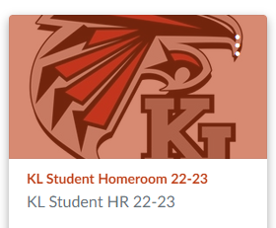
Today: You will complete the Graduation Requirements Worksheet
FIRST: If you completed a Grad. Requirement worksheet last year, during the registration homeroom lesson, please go to your Homeroom folder in your One Drive to update the document.
OR
Go to the KL Student Homeroom Canvas course 22-23 and find AND DOWNLOAD the KL Credit Evaluation Worksheet.
If you have not joined the course- use this code:
https://kentk12.instructure.com/enroll/XDPR68
OR
Download under Resources on the 23-24 Registration link: https://kentk12.instructure.com/courses/61151
NEXT:
Login to Skyward
Click on the Graduation Requirements link on left side of screen

Slide 3
Reading the Graduation Requirements Screen
Complete
Lists the number of credits you have completed.
In Progress
Lists the courses in which you are currently enrolled in.
Remaining
Lists the courses in which you are currently enrolled in and still need to complete.

Slide 4
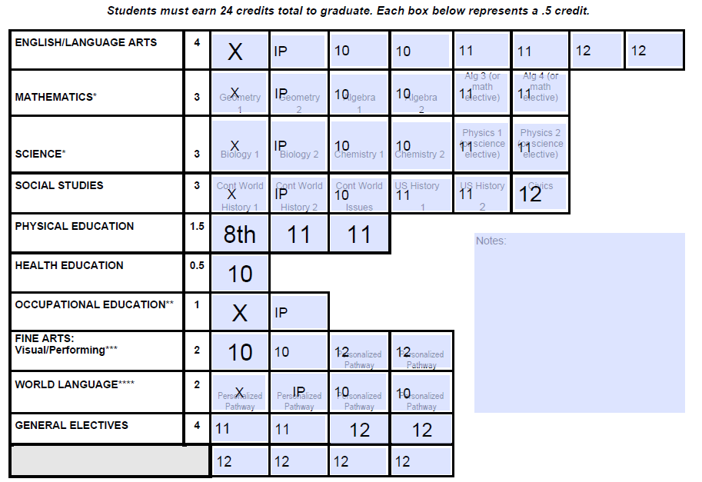
Complete your Graduation Requirements worksheet
On the right is an example of how you can complete your Graduation Requirement Worksheet
Put a “X” in the courses you have completed. Put an “NC” in classes that you did not earn credit in 1st semester.
Put an “IP” (in progress) in the boxes for classes you are currently taking.
Put a “10”, “11” or “12” in the boxes for classes you know you need to take and what year you will take them
Use the “Notes” form for any questions you may have.
When your Grad Requirement document is complete save to your One Drive Homeroom folder.
If you do not already have a Homeroom folder in your One Drive, create one now. SAVE THIS DOCUMENT.
Sample Grad Requirement worksheet

Slide 5
Graduation Requirements Worksheet results
Using this worksheet, you can now see what classes you should register for next year.
English –full year
All 10th graders will take English. You can choose between Core English or College in the High School.
Algebra 1-2 – full year
If you’ve completed Algebra 1-2 and Geometry you may be registering for Algebra 3-4
If you’ve completed Geometry, Algebra 1-2 and Algebra 3-4 you may be registering for Precalculus.
Chemistry – full year
All 10th graders will take Chemistry. You can choose between Core Chemistry or College in the High School
Contemporary World Issues– one semester
10th graders can also choose to take a full year of AP Human Geography (APHG).
Health – one semester
World Language – full year
Arts – full year
*If you chose APHG, you will only have room for a .5 (one box) of Art.
Sample Grad Requirement worksheet

Slide 6
Make sure your Graduation Requirement Worksheet is saved where you can find it.
Counselors will be coming to one of your classes next week to talk about registration!
Be in class and ready to plan for next year!

