Slide 1
KSD Graduation Requirements
1
Notes:
In this presentation we will be going over your high school graduation requirements. It is important to familiarize yourself with these requirements as they should help guide your course selections. We will breakdown what they are, how to meet them, and where to track them.

Slide 2
KSD Graduation Requirements: Credits/Classes
LANGUAGE ARTS 1 credit each year – grades 9-12 | 4 | ENG 9 | ENG 9 | ENG 10 | ENG 10 | ENG 11 | ENG 11 | ENG 12 | ENG 12
SOCIAL STUDIES | 3 | World History | World History | CWI | U.S. Hist | U.S. Hist | Civics
MATHEMATICS | 3 | Algebra 1 | Algebra 2 | Geometry | Geometry | Algebra 3 | Algebra 4
LABORATORY SCIENCE | 3 | Biology | Biology | Chemistry | Chemistry
PHYSICAL EDUCATION | 1.5
HEALTH | .5 | Health
CTE | 1
ARTS | 2
17 core credits
3 Personal Pathway credits
WORLD LANGUAGE | 2
4 elective credits
ELECTIVES | 4
24 CREDITS REQUIRED
2
Notes:
Every student needs a total of 24 credits to graduate high school. This is the breakdown of graduation requirements by subject and number of credits. For your core classes, English, Social Studies, Math, and Science, the best way to meet these requirements is to take one of each every year until you fulfill that requirement. You will notice some credits are highlighted in green, these are Personal Pathway credits which means there is some flexibility in how they are met depending on your high school beyond plan. A reminder that world language classes need to be two consecutive years of the same language, for example, taking Spanish 1/2 and then Spanish 3/4. If you decide to take more credits than needed in one subject, the additional credits will go towards fulfilling your electives.

Slide 3
Additional Graduation Requirements
Washington State History
Taken in 7th grades in KSD
High School & Beyond Plan
Graduation Pathway
This will be covered in 3rd period
3
Notes:
These are the additional Washington State graduation requirements. If you completed 7th grade in the Kent school district, then you could have already met the Washington State History requirement. If you did not, get in touch with your counselor and they will help you find the best way to fulfill that requirement. Students will also need to complete a high school and beyond plan and pass the math and ELA sections of the SBA. There are also graduation pathways students can pursue in place of the SBA and those will be covered later in your 5th period class.

Slide 4
Personal Pathway Requirement
It is based off students interests and the High School & Beyond Plan
Certain credits (1.0 Art and/or 2.0 World Language) are flexible, meaning you can design your pathway to meet your post secondary plans
PPR are related courses that lead to a specific post high school career or educational outcomes
A conversation with the student, parent and counselor to discuss replacing the Art and/or World Language credits
4
Notes:
Personalized pathway Requirement or PPR's are courses that will lead to a specific post high school career or educational outcome. For example, if you were interested in pursuing a degree or career in computer science, this would be outlined in your high school and beyond plan and you could take more classes that aligned with computer science. These would be in place of other credits such as some of your art or world language credits. If you are interested in pursuing a personalized pathway, you can request a meeting with your counselor to discuss the future options.

Slide 5
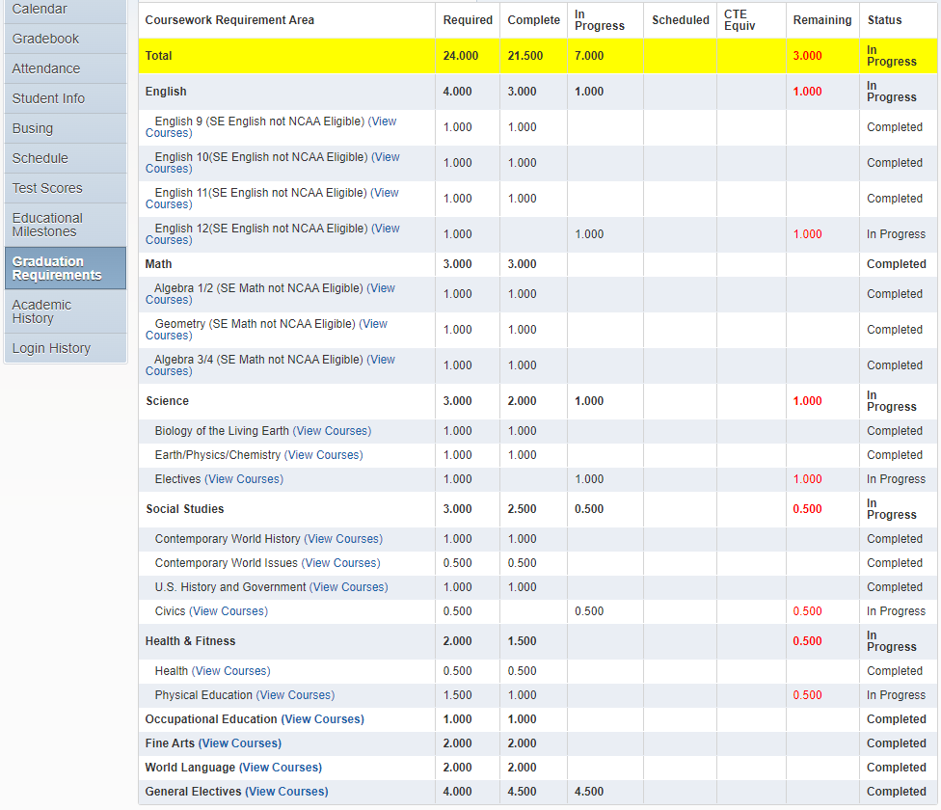
Reviewing credits
Do you have what you need to graduate?
Log into skyward. On the left of the screen, click on “Graduation Requirements”
Don’t know what a class can count for? Look in the course catalog or ask your counselor.
Course Catalog can be accessed from the KM home page.
Click on the teaching and learning tab
Click on Course Catalog.
5
Notes:
Throughout your high school experience, it's important to review your credits to make sure you are on track to meet the requirements for graduation. To review your credits, log into your skyward account on your laptop and select the graduation requirements tab on the left-hand side of the screen. If you don't know what credit a class can count for, you can look in the course catalog or ask your school counselor. A link to the course catalog is located on the counseling Canvas page or on the Kent-Meridian High School website under the teaching and learning tab. Your school counselor will also be able to assist you in determining which class can count for which credit.

Slide 6
Reviewing credits
Look at the top row in bold. You will see different categories.
Required – total # of credits required for each subject area
Complete - # of credits you have earned
In Progress -- # of credits you are currently enrolled in ( not including online or running start classes)
Remaining -- # number of credits remaining in a subject IF classes “In Progress” are passed
Status – Either “In Progress” or “Completed” (assumes you passed the class)
6
Notes:
Once you have access to your graduation requirements in skyward, you will notice different categories to review. The "required" category is the total number of credits required for each subject area. For example, you'll notice that there are four total credits of English required to graduate. The “complete” category shows the number of credits you have earned for each subject. The “in progress” category shows the number of credits you are currently enrolled in. The “remaining” category, highlighted in red, is especially important to review as you progress through high school. This category shows the number of credits remaining in each subject assuming that you passed your “in progress” classes. For example, looking at this student's graduation requirements, they have completed 3 of the 4 required English credits, meaning they still need 1 English credit for graduation. Lastly, the “status” column shows whether the class is in progress or has been completed.

Slide 7
College Entrance Requirements
College Academic Distribution Requirements (CADRS)
English | 4 Credits
Math | 3 Credits*
Science | 3 Credits
Social Studies | 3 Credits
World Language | 2 Credits ( same language)
Career and Technical Education | 1 Credits
Art | 1 Credits
* Senior year math requirement – 1.0 credit of math or algebra- based science course or already completed math through Pre-calculus/trigonometry.
7
Notes:
If you're considering attending a four-year college or university after high school, these colleges typically require 4 English credits, 3 math credits, 3 science credits, 3 social studies credits, 2 world language credits in the same language, 1 Career and Technical education credit, and 1 art credit.
Before picking your classes for next year, please take the time to review your completed and current class credits and your progress towards graduation. If you are concerned about your graduation credits or think you are behind in credits, please email your counselor to review credits and create a plan.

