Slide 1
Graduation Pathways
Notes:
This period, we are going to talk about graduation pathways.

Slide 2
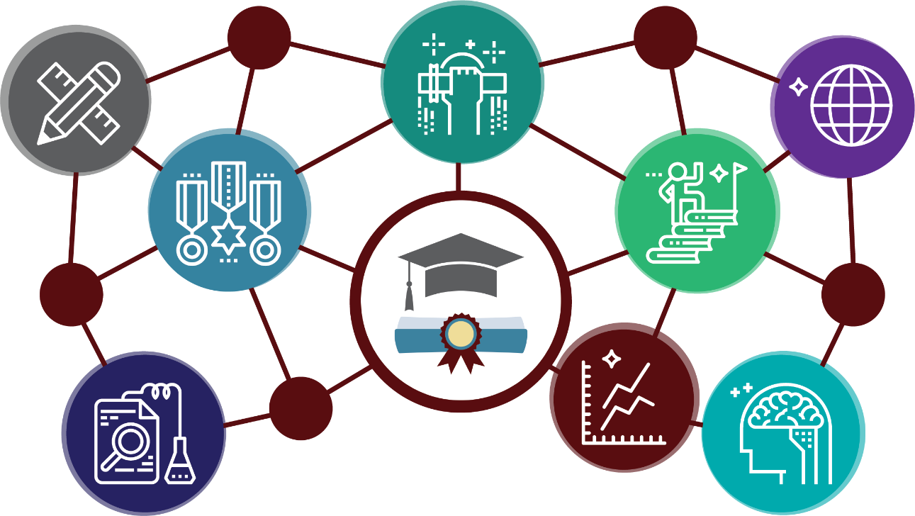
What is a Graduation Pathway?
The graduation pathway is a state requirement that allows students to demonstrate readiness for a meaningful first step after high school.
Notes:
The Graduation Pathway is a state graduation requirement that allows students to demonstrate their readiness for a meaningful first step after graduating from high school.

Slide 3
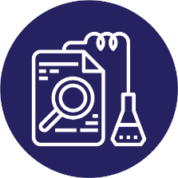
SBA
Bridges and Transition Courses
AP/IB
Dual Credit
CTE Sequence
SAT/ACT/ASVAB
Notes:
There are six graduation pathways that you need to know about. The CTE sequence pathway, the ASVAB pathway, the SBA pathway, the SAT or ACT pathway, the AP/IB pathway, and the Dual Credit pathway. Students can choose any pathway and some may meet multiple pathways to fulfill their graduation requirements. But depending on what your post high school plans are you’ll want to pick a pathway that makes sense for you.

Slide 4
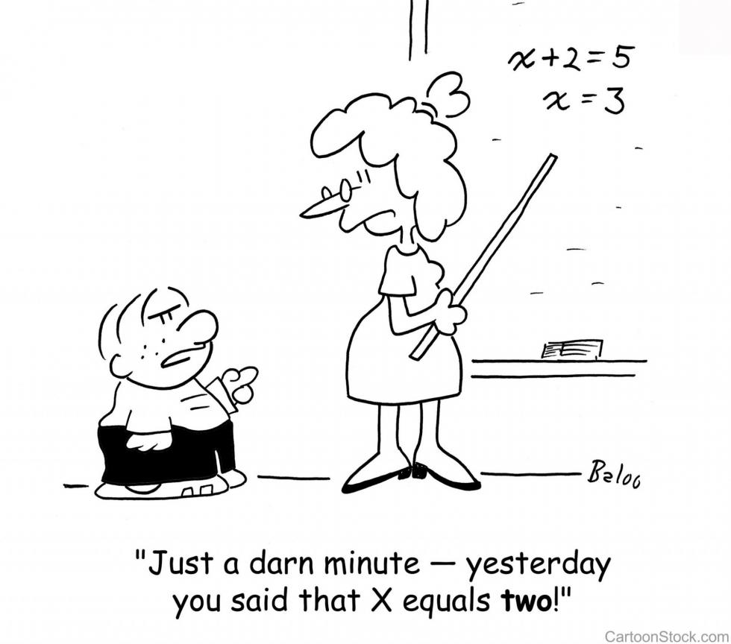
Smarter Balanced Assessments (SBA)
ELA score of 2548+
Math score of 2595+
Notes:
Are you thinking of attending a two-year college after high school? If so, the SBA pathway may be right for you. Scoring high on your 10th grade smarter balance assessment also known as the SBA exam is the easiest way to meet the graduation pathway requirement. All 34 of Washington's public community and technical colleges have agreed to use SBA scores for placement. As long as you score a level three or four, those colleges won't require remedial courses or additional tests before you can enroll in college level math or English. To meet the graduation pathway requirement, you need to score 2548 or better in English and the 2595 or better in math.

Slide 5
Bridges to College Courses
Courses offered at KM:
Bridges to College English
Bridges to College Math
Notes:
Students who have not completed a graduation pathway in Math or ELA will likely be placed into Bridges classes for ELA and/or math their senior year. To use this course for college math or English placement a B must be earned, to graduate high school and use this as your pathway a passing grade (D or higher) must be earned.

Slide 6
Transition Courses
For the purposes of graduation pathway options, transition courses are English and math courses that, based on their final grade, allow students to place directly into credit-bearing college level courses (courses with college course numbers of 100 or above).
KSD has agreements with Green river Community College, Bellevue College, and Highline Community College for the following courses:
Core English 11, Core English 12, AP English, AP Math, CHS English, IB English, IB Math
Notes:
If you are using a transition course other than Bridges to College as your graduation pathway it will be important for you to discuss details with your counselor. Your intention must be to attend the college who the agreement is with, and you must have a specific grade in the course.

Slide 7
CTE Pathway
2.0 CTE credits in:
Business and Marketing
Health Sciences
Human Services
Skilled and Technology
S.T.E.M.
Plus, the class must award dual credit or lead to a certificate.
Notes:
Are you thinking about going into a career straight after high school? If so CTE pathway may be a good fit for you. The CTE pathway requires that you complete 2 credits within one of the following pathway areas: Business and Marketing, Health Sciences, Human Services, Skilled and Technical, or STEM. Plus, the classes that you take must award a dual credit or lead to a certificate

Slide 8
ASVAB
Armed Services Vocational Aptitude Battery
Score of 31 +
Notes:
Do you want to join the military after high school? You will need to complete the Armed Services Vocational Aptitude Battery, or ASVAB. Scoring well on the ASVAB will open up more opportunities or careers in the military. A score of 31 or higher will meet the graduation pathway for both English and math.

Slide 9
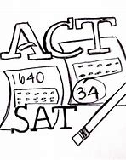
SAT / ACT exams
SAT Scores needed
ELA – 410
Math – 430
ACT Scores needed
ELA – 14
Math -- 16
Notes:
Another good option for college bound students to complete their graduation pathway is to meet the SAT or ACT minimum cut scores in both the English language arts and math sections of the exam. You need to sign up for these tests outside of school and share your scores with your counselor.

Slide 10
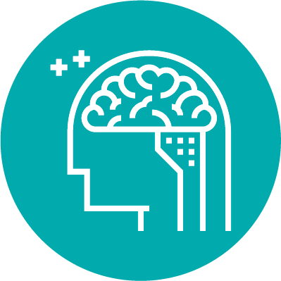
Dual Credit
Dual Credit
Courses in Math and English
College in the HS English and Math classes
Business Math
For English
For Math
Notes:
Dual credit classes are KM classes offered where a student can earn high school credit and earn college credit at the 100-level or higher.

Slide 11
AP and IB classes
Notes:
If you are using an AP or IB class to meet your graduation pathway you need to earn a C+ or higher in both semesters.

Slide 12
SBA
Transition Courses
AP/IB
Dual Credit
CTE Sequence
SAT/ACT/ASVAB
Notes:
Please remember that you only need to complete one of the six possible pathways to satisfy the graduation requirement. Your counselor will be available to discuss this during registration, or they are available by email if you have questions!

